Slide 1
Fitness Dependent Optimizer: Inspired by the Bee Swarming Reproductive Process
Author Names:
1. JAZA MAHMOOD ABDULLAH
2. TARIK AHMED RASHID
Guided By:
Mr. B. Srinivasan, B.E., M.Tech.,
School of Computing, AP-III, IT, SASTRA University
srinivasan@core.sastra.edu
Published in IEEE Access ( Volume: 7 )
Date of Publication: 22 March 2019
Publisher: IEEE
DOI: 10.1109/ACCESS.2019.2907012
Scopus Index: 21100374601
Mini-Project Members:
1. Preethi T (121015078)
preethitamilvendan@gmail.com
2. Raghunathan MS (121015081)
bargav32@gmail.com
3. Surya Narayanan S (121015098)
suryan0800@gmail.com

Slide 2
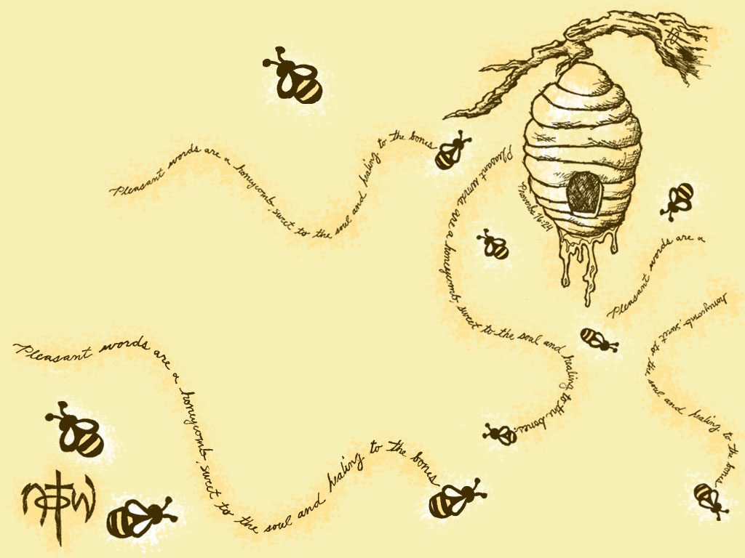
Index
Introduction
Abstract
Bee Swarming process
FDO Algorithm
Flow Chart of FDO
Result (comparison with other algorithm)
Real world Applications

Slide 3
Introduction
Optimization ? (solution search algorithm)
Swarm intelligence ? (collective knowledge)
Evolutionary computation ? (nature inspired)
Metaheuristic algorithms ? (self learn from experience)
Fitness value? (how optimal is the current solution)
Pace? (Velocity of movement from one feature set to another)
Feature Set ? (parameters)
Search Space, X ? (parameters, range)
Random number, r?
Fitness weight ?
Dimension/Feature ? (each parameter)

Slide 4
Abstract
To solve feature searching problems with large search area.
We find (search) optimal feature based on the fitness value and Pace.
Inspired from the Bee Swarming Process.
searches a solution by trial and error.
Hopes the solution is of good quality.
Corrects its mistake every time they move.
Better and comparative results with Genetic , Dragonfly and Whale Optimization algorithm.
Eg: Aperiodic Antenna Array Designs and Frequency Modulated Sound Waves.

Slide 5
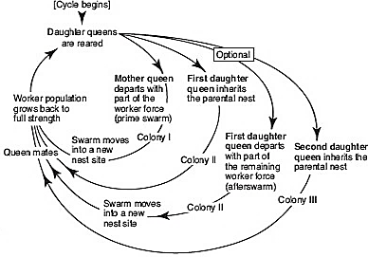
Bee Swarming Process

Slide 6
FDO Algorithm
randomly choose some features and move towards the best by calculation fitness for every bee and comparing.
While moving from one feature to another feature, we find a pace (velocity) at which it should change. We find the Pace(velocity), by comparing it with the best Bee feature set.

Slide 7
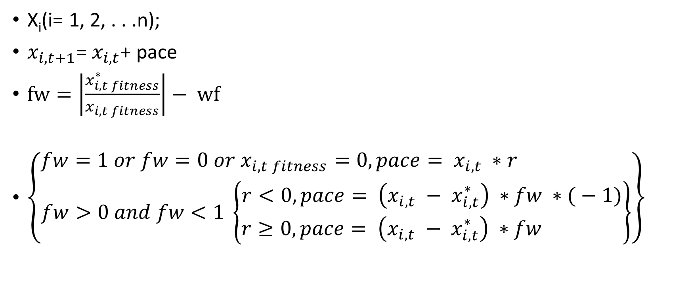
FDO Formula
X_{i}(i= 1, 2, . . .n);
$x_{i,t+1}$= $x_{i,t}$+ pace
$fw=\left|\frac{x_{i,t fitness}^{∗}}{x_{i,t fitness}}\right|− wf$
$\left\{\begin{matrix}fw=1 or fw=0 or x_{i,t fitness}=0,pace= x_{i,t} ∗r \\ fw>0 and fw<1 \left\{\begin{matrix}r<0, pace= \left(x_{i,t} − x_{i,t}^{∗}\right) ∗fw ∗( − 1) \\ r≥0, pace= \left(x_{i,t} − x_{i,t}^{∗}\right) ∗fw \end{matrix}\right\}\end{matrix}\right\}$

Slide 8
Flow Chart
Select N random Points (feature set)(scout bees)
No
Find Best Points (Scout Bee) using fitness value
Yes
Still more points or still more iterations
Find Pace, new fw using Best Bee Fitness value
No
Yes
Update new Points using Pace
Yes
Yes
fw_{i, t+1} > fw_{i, t}
fw_{i, t+1} > fw_{i, t}
No
Yes
Using previous best Pace, find fw
Random Walk
No
fw_{i, t+1} > fw_{i, t}
Note : fw – Fitness Value, pace – how far the point is moved

Slide 9
Result with other Algorithms
Comparison with Particle Swarm Optimization algorithms like:
Genetic algorithm (GA),
Dragonfly algorithm (DA) and
Whale Optimization algorithm (WOA)
As a result, in some cases, it outperforms these algorithms and performs comparably in other cases.
Comparatively quicker than traditional algorithms like Gradient-based and quadratic algorithms.
Compare what ? ( how quick solution converges to optimum, Time Complexity, Space Complexity )

Slide 10
Real World Applications
Find optimal location to build apartments
Optimal Aperiodic Antenna Array Designs
Optimal Frequency Modulated Sound Waves.

Slide 11
THANK YOU!

